Slide 1
Linear Regression
CSE 329

Slide 2
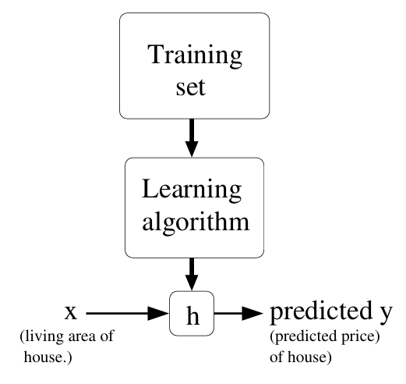
Supervised Learning (Recap)
Hypothesis
Features
Target

Slide 3
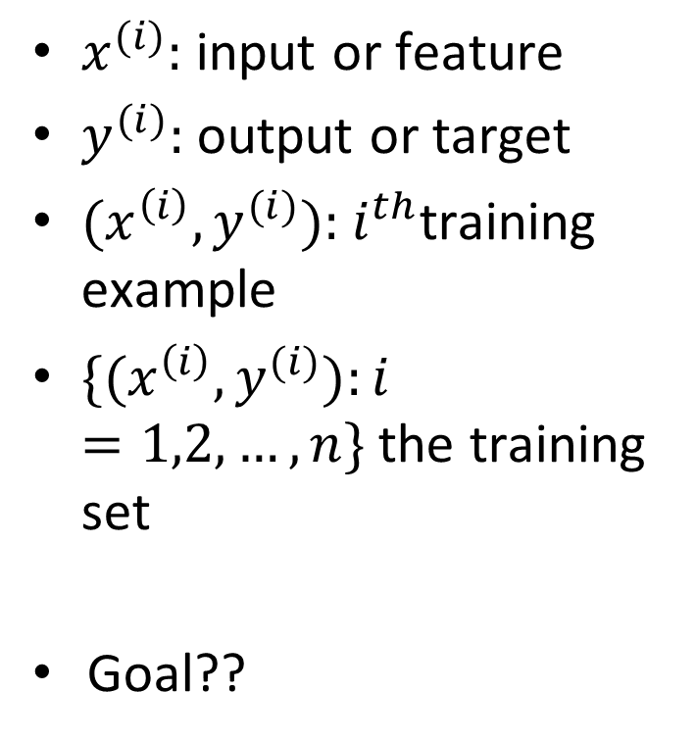
Supervised Learning
$x^{(i)}:$ input or feature
$y^{(i)}:$ output or target
${(x^{\left(i\right)},y}^{(i)}):$ $i^{th}$training example
${\{(x^{\left(i\right)},y}^{(i)}):i=1,2,…,n\}$ the training set
Goal??
Hypothesis
Features
Target

Slide 4
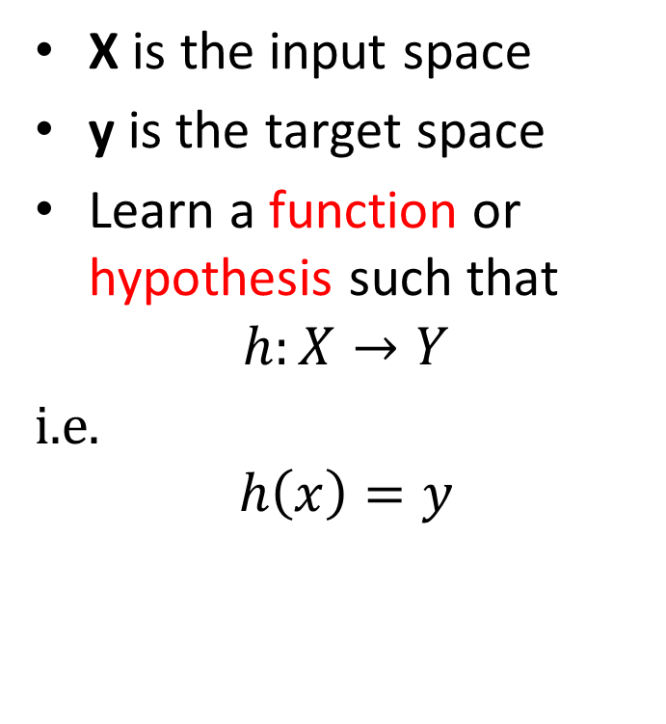
Supervised Learning
X is the input space
y is the target space
Learn a function or hypothesis such that
$$h:X→Y$$
i.e.
$$h\left(x\right)=y$$
Hypothesis
Features
Target

Slide 5
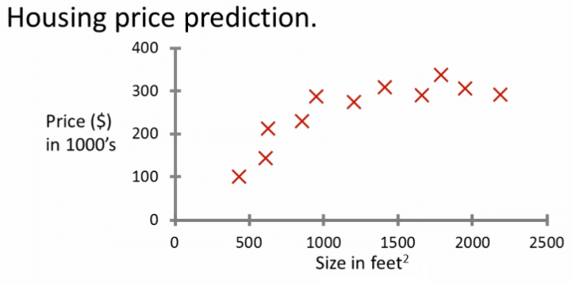
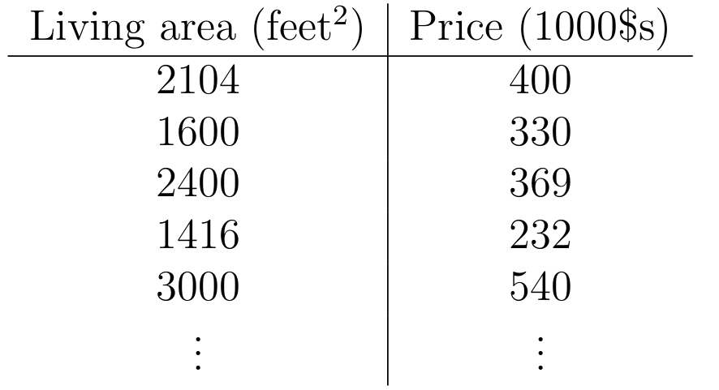
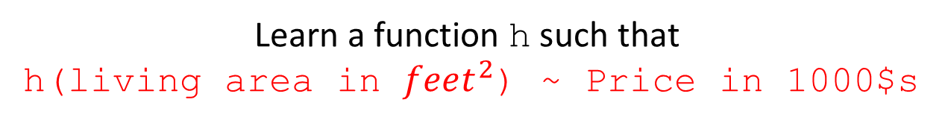
Housing Price Prediction
Regression !!!
Learn a function h such that
h(living area in $feet^{2}$) ~ Price in 1000$s

Slide 6
Regression vs Classification
Regression
Target variable is continuous
Example,
Housing price prediction
Classification
Target variable can take only small number of discrete values
Example,
Email classification (Spam vs Ham)

Slide 7
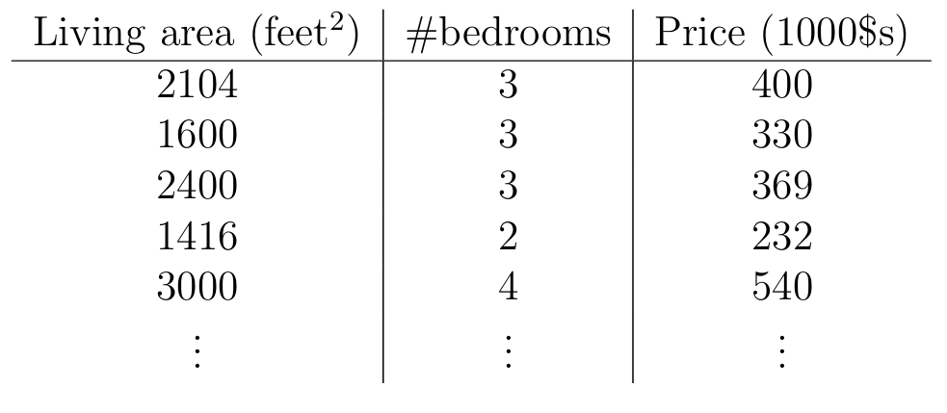

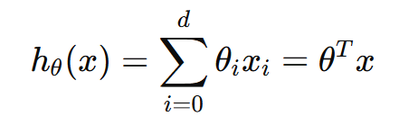
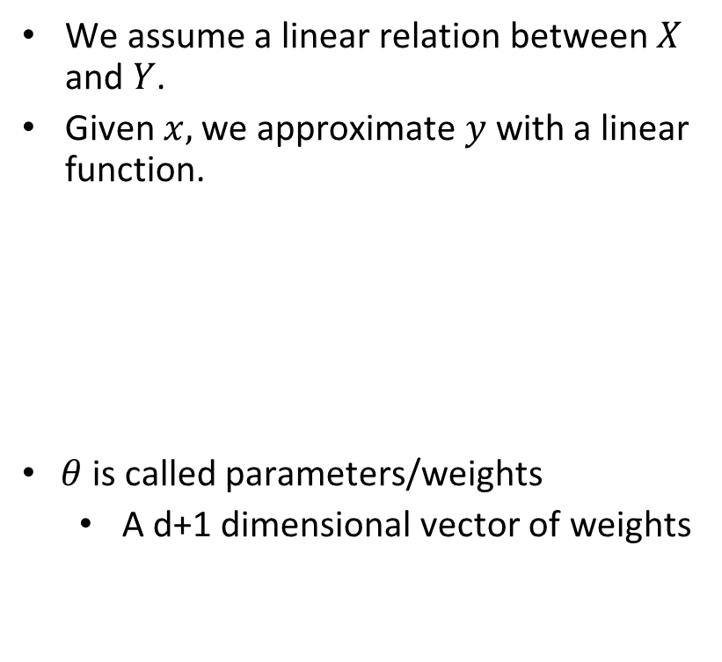

Linear Regression
We assume a linear relation between $X$ and $Y$.
Given $x,$ we approximate $y$ with a linear function.
$θ$ is called parameters/weights
A d+1 dimensional vector of weights
Housing price prediction with two features
$$x_{0}=1$$

Slide 8
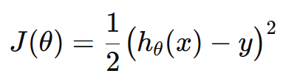
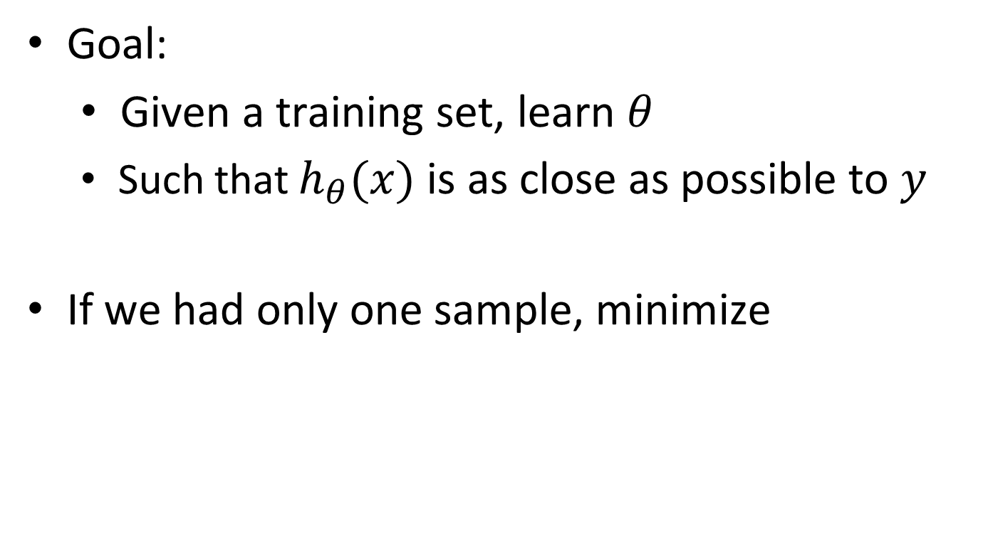
Linear Regression
Goal:
Given a training set, learn $θ$
Such that $h_{θ}(x)$ is as close as possible to $y$
If we had only one sample, minimize

Slide 9
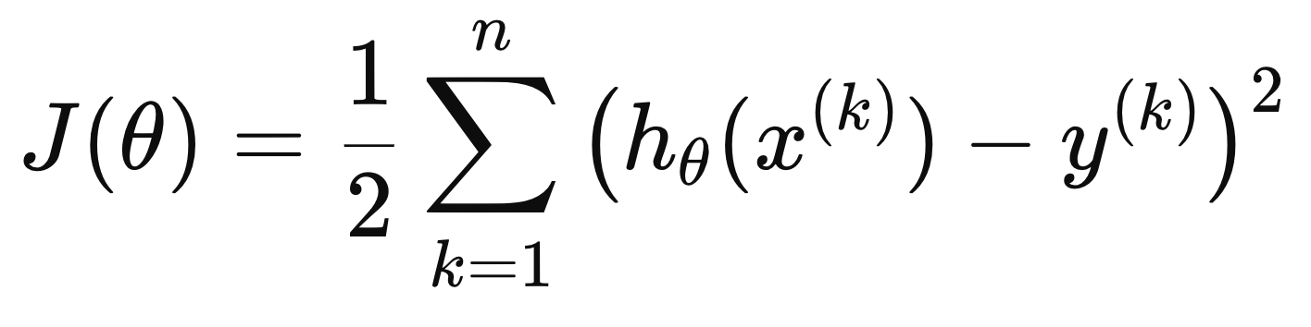
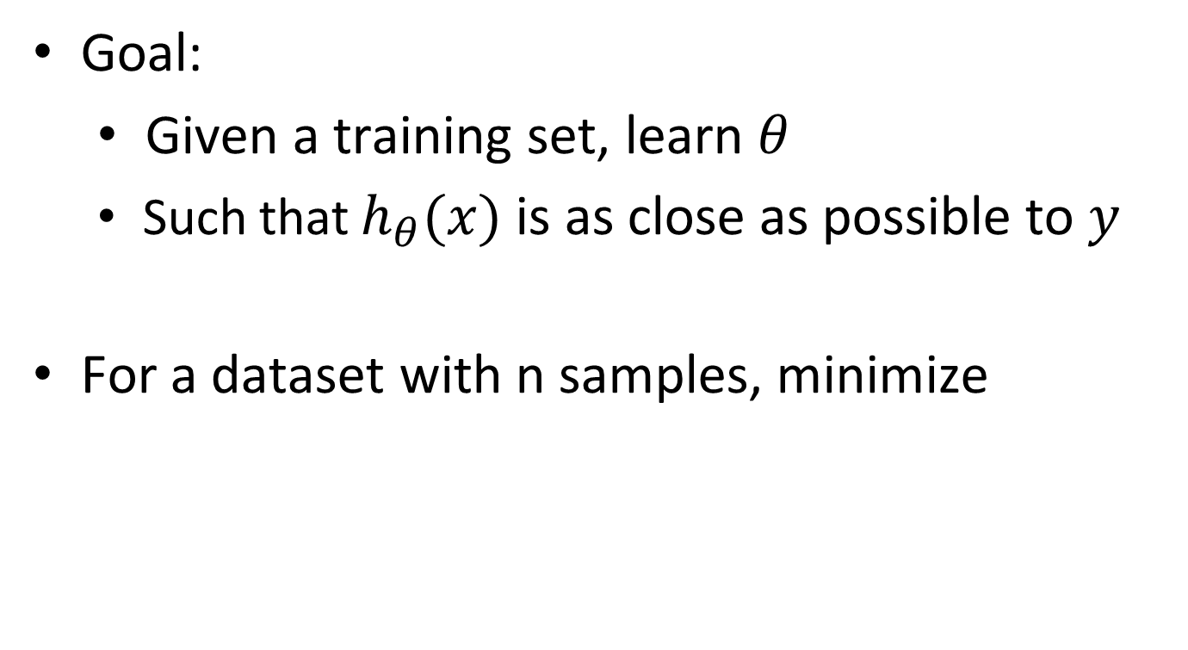
Linear Regression
Goal:
Given a training set, learn $θ$
Such that $h_{θ}(x)$ is as close as possible to $y$
For a dataset with n samples, minimize
Least Squares (LS)
Cost Function/Loss Function

Slide 10

Linear Regression
Goal: Choose $θ$ to minimize $J(θ)$
$$θ^{∗}=argmin_{θ}J(θ)$$
How?

Slide 11
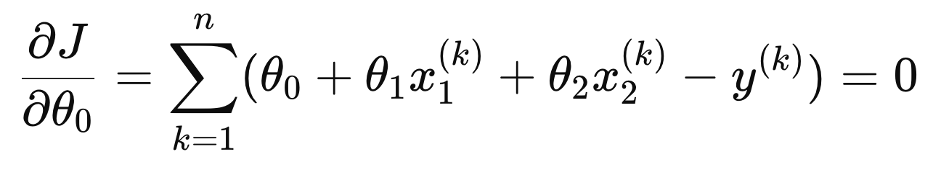
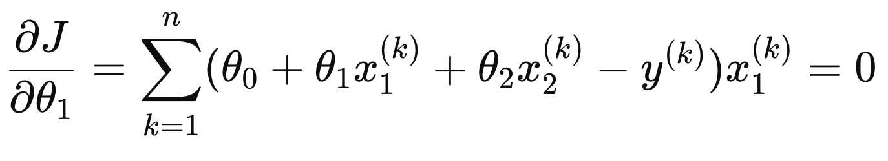
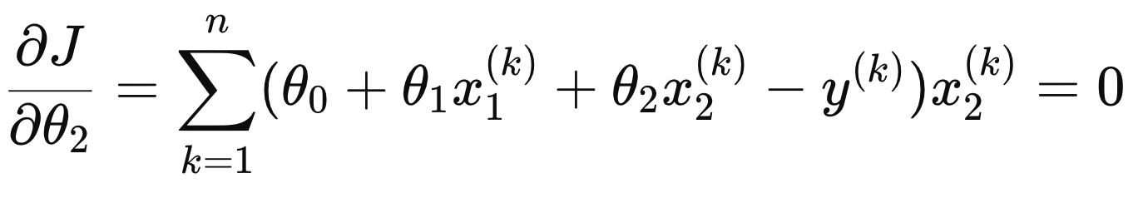

Linear Regression
Goal: Choose $θ$ to minimize $J\left(θ\right)$
$$θ^{∗}=argmin_{θ}J\left(θ\right)$$
Set partial derivatives to 0 to obtain minima

Slide 12
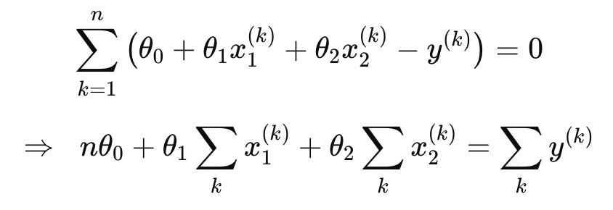
Linear Regression
Simplifying the partial derivative equations,

Slide 13
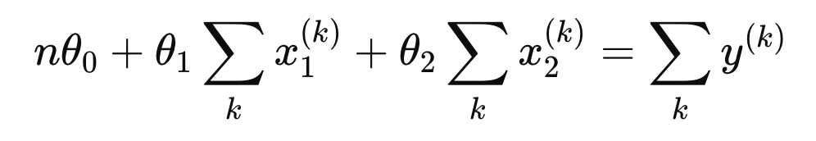
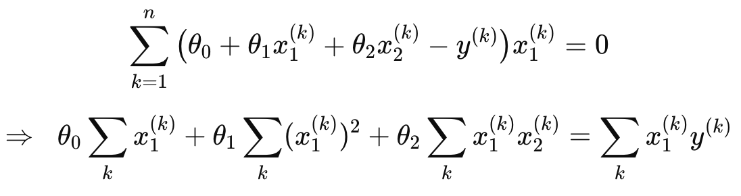
Linear Regression
Simplifying the partial derivative equations,

Slide 14
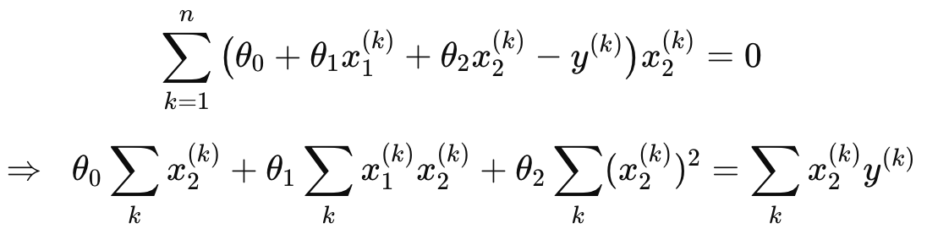
Linear Regression
Simplifying the partial derivative equations,

Slide 15
Linear Regression
Simplifying the partial derivative equations,
System of Linear Equations

Slide 16
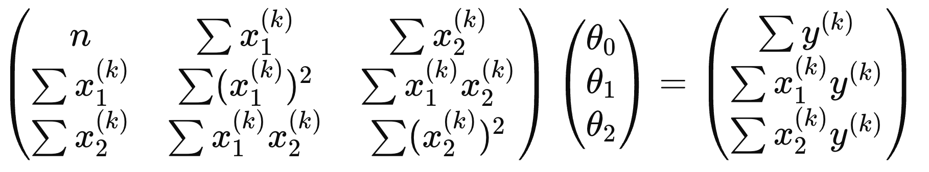
Linear Regression
Simplifying the partial derivative equations,
Vectorized Form

Slide 17
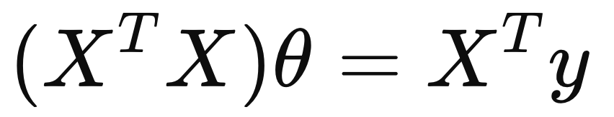
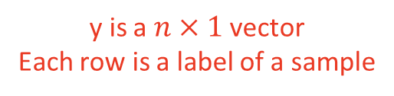
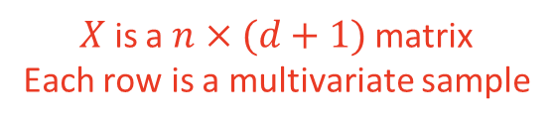
Linear Regression
Simplifying the partial derivative equations,
Vectorized Form
$X$ is a $n×(d+1)$ matrix
Each row is a multivariate sample
y is a $n×1$ vector
Each row is a label of a sample

Slide 18
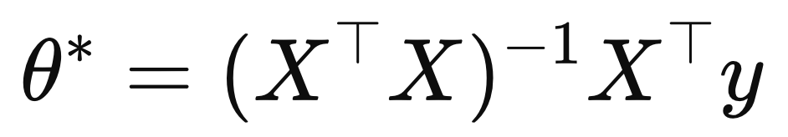

Linear Regression
Solve the system of linear equations to get $θ^{∗}$
Normal Equation

Slide 19

Linear Regression
Once trained predict housing prices with,
$$\hat{y}={{(θ}^{∗})}^{T}x$$

Slide 20
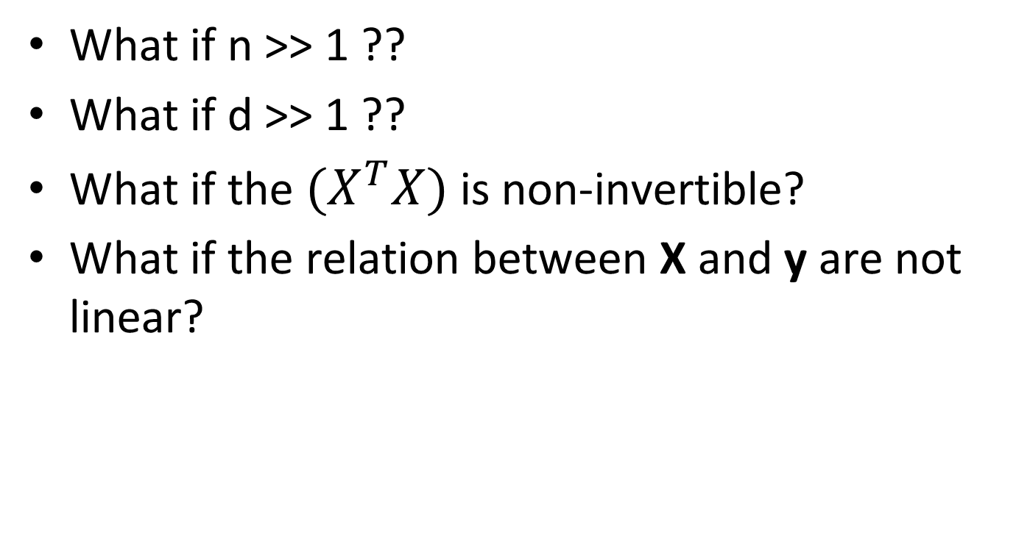
What if n >> 1 ??
What if d >> 1 ??
What if the $(X^{T}X)$ is non-invertible?
What if the relation between X and y are not linear?

Slide 21
Reference
Dive into Deep Learning (d2l)
Sections 3.1 (up to 3.1.2), 3.4
Deep Learning [Optional Reading]
Section 5.1.4

